Slide 1
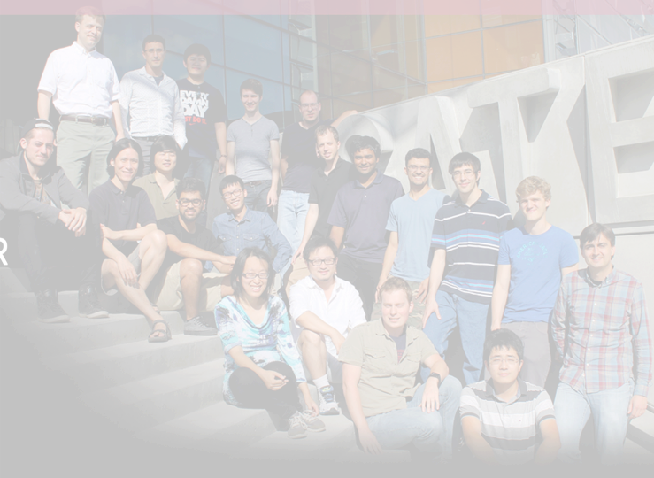
IC3 Intro and
Retreat Preview
Ari Juels
Co-Director, IC3
Professor, Jacobs Technion-Cornell Institute, Cornell Tech

Slide 2
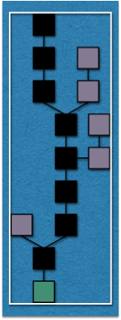
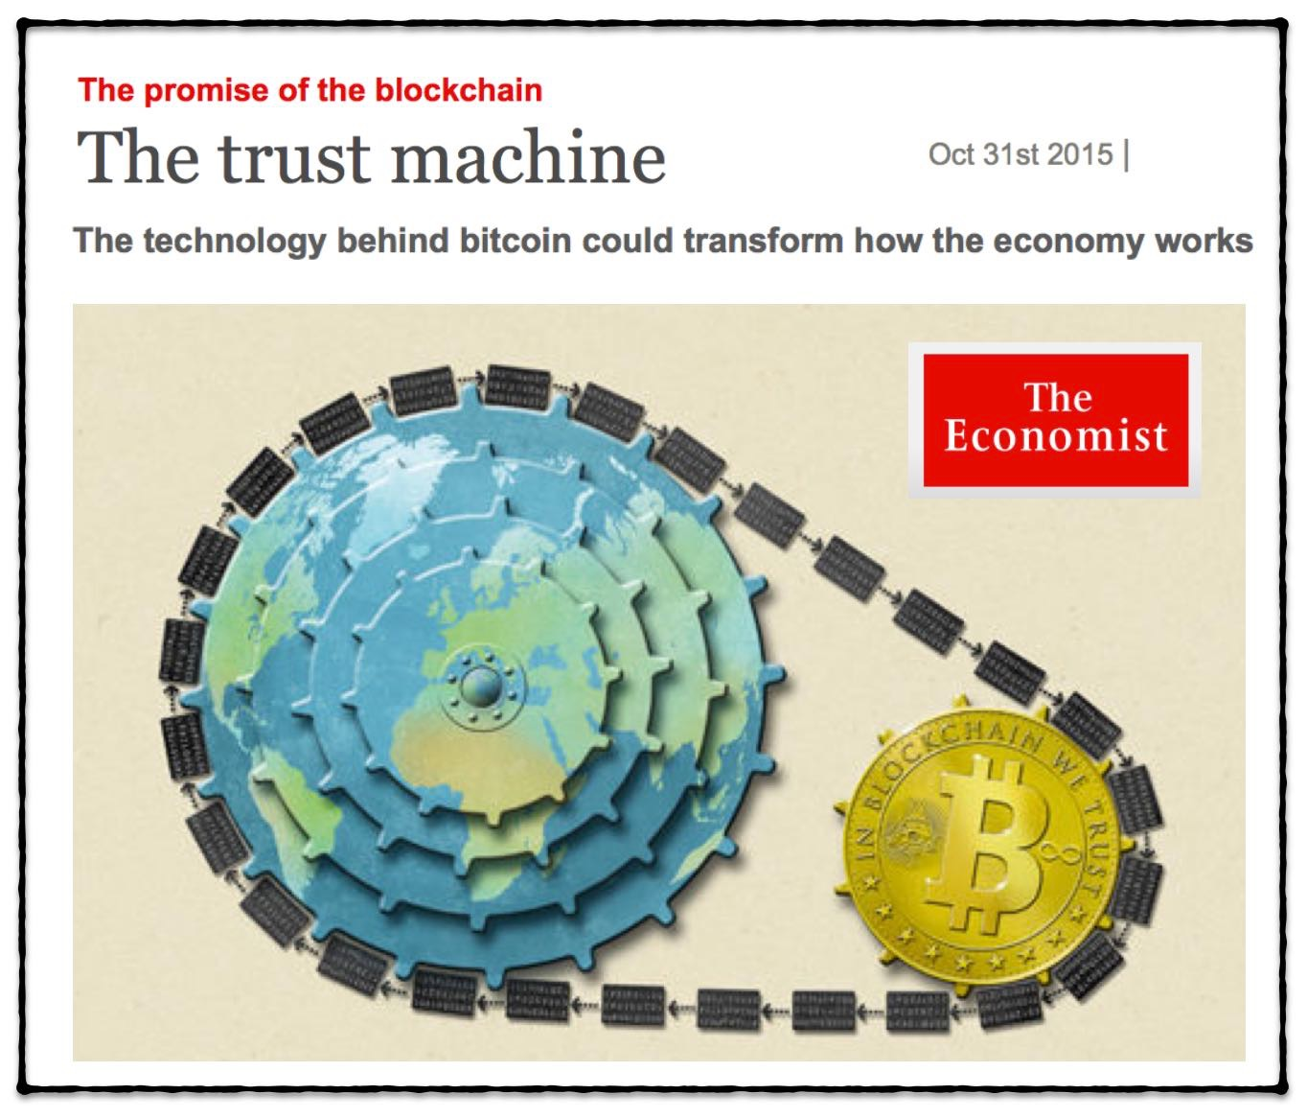
Blockchains: The Promise

Slide 3
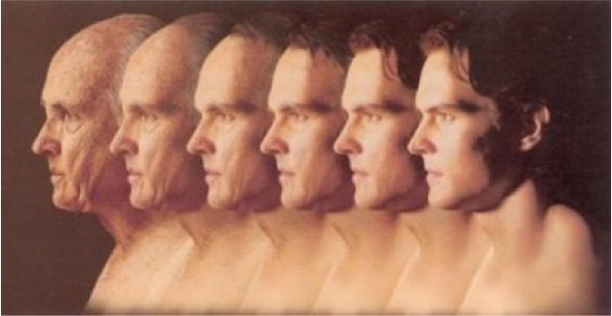
Reversing aging

Slide 4
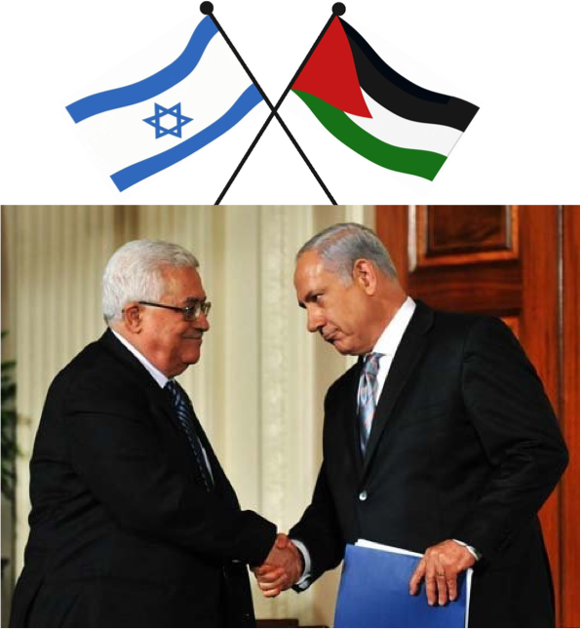
Bringing peace to Middle East

Slide 5
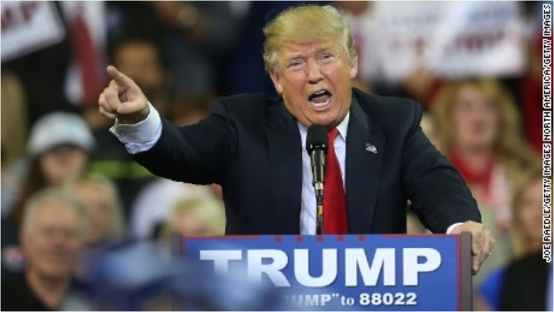
Saving the Republican Party

Slide 6
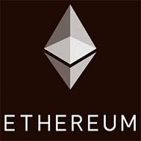
Real indices of promise
Incredible array of participants here today:
Bitcoin market cap: circa $7 Billion
Blockchain VC funding to date: $1.1+ Billion
Projected bank investment in 2017: $1 Billion¹
¹Source: Magister Advisors, http://magisteradvisors.com/blockchain-bitcoin-2016-a-survey-of-global-leaders/

Slide 7
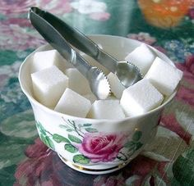
But the community of core innovators is fracturing…
… often over trifles
One megabyte blocks or two, Dear?

Slide 8
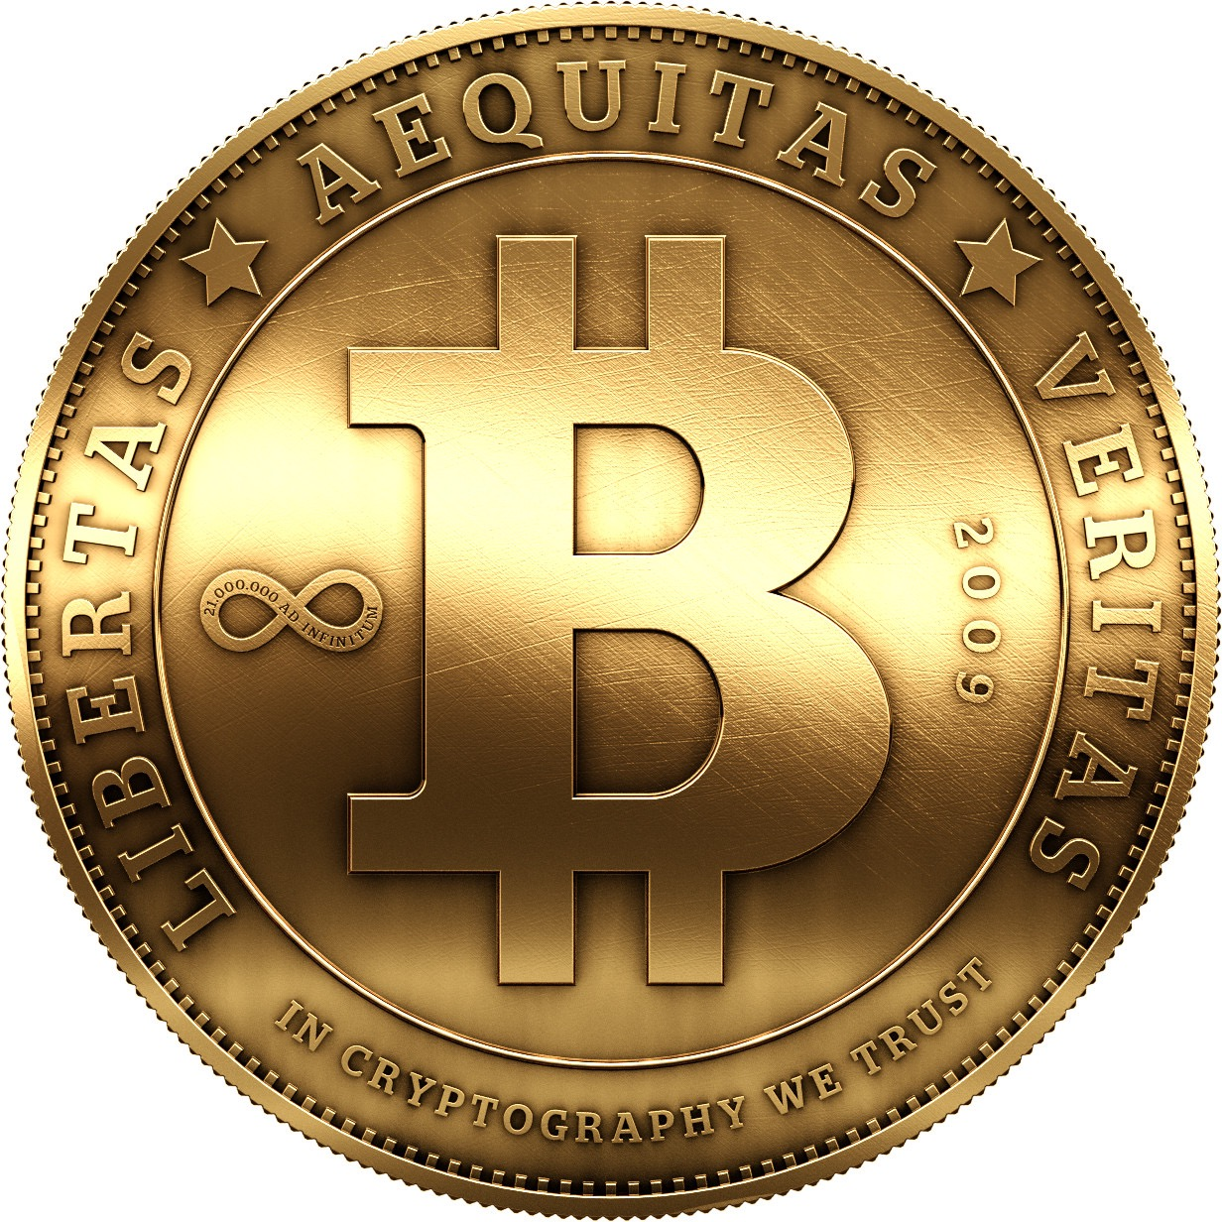
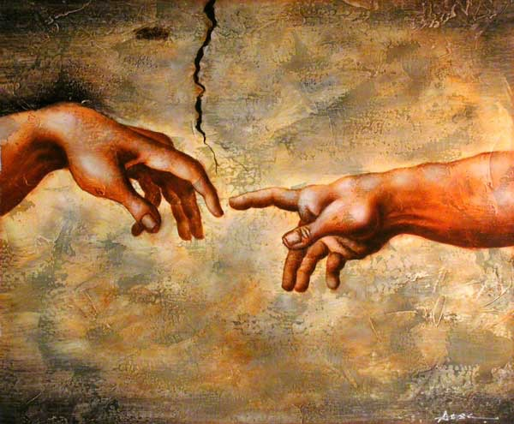
In the Beginning, There Was The Coin
The Year 1 A.B. (a.k.a. 2008)
The Genesis Block

Slide 9
Actually…
31 B.B.
1977
1982
1993
1996
2002
1 A.B.
9 A.B.
Karma: P2P currency
First proof-of-work-based cryptocurrency (Rivest and Shamir)
Proofs of work introduced (Dwork and Naor)
Anonymous cryptocurrency introduced (Chaum)
RSA invented—digital currency an early proposed application
Bitcoin / blockchains underpinned by academic / scientific innovation

Slide 10
IC3 goals
Bring science of blockchains to forefront of blockchain technology development
Partner academia with industry to deliver innovation embodied in code
Provide independent expertise
Try to solve biggest problems not monolithically, but in agenda of
Five Grand Challenges

Slide 11
Tempest in a teapot?
#1
One megabyte blocks or two, Dear?

Slide 12
#1: Scaling and Performance
Don't tweak parameters. Reinvent consensus.
Challenge: Scale up blockchains to handle intensive global workloads
What IC3 is aiming to do:
Decentralized blockchains:
Study of limitations in current systems
Achieving much higher throughput (100 tx / sec)
Permissioned / consortium blockchains:
Toward 100,000+ tx / sec via hybridization and sharding

Slide 13
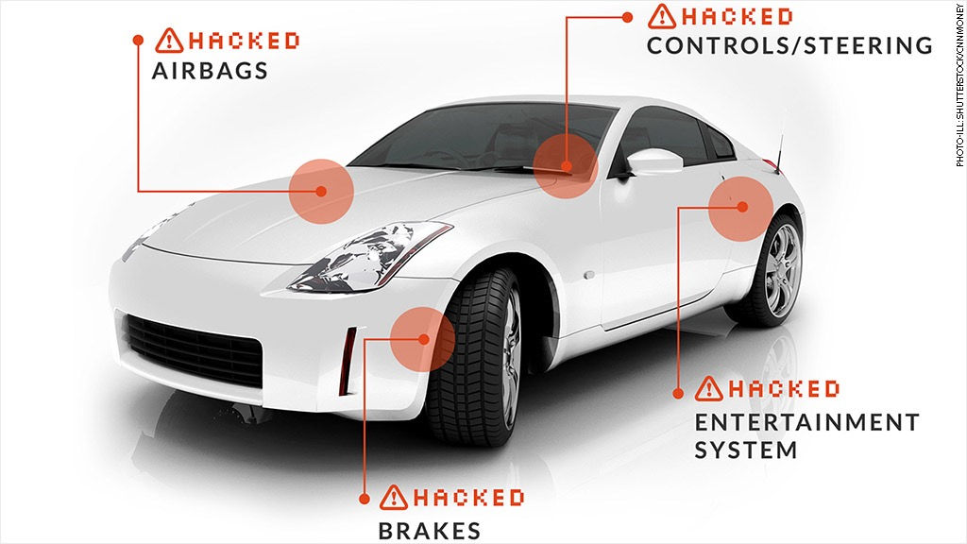
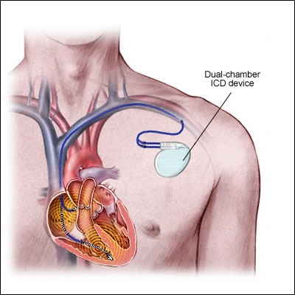
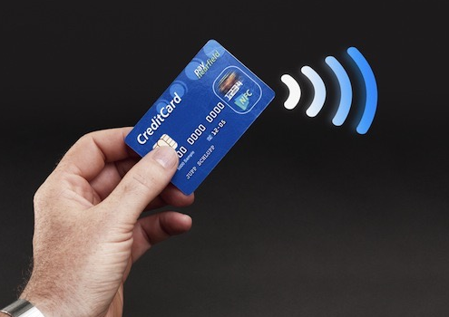
#2
Automobiles
Medical devices
RFID devices
Law of history? Every industry must (painfully) relearn the lesson that rigorous security is critical.

Slide 14
#2: Correctness
Challenge: Defy history! Make it easy for blockchain developers to produce secure protocols and code.
What IC3 is aiming to do:
Programming language techniques to create useable semantics and correct code
Cryptographic protocols with security proofs

Slide 15
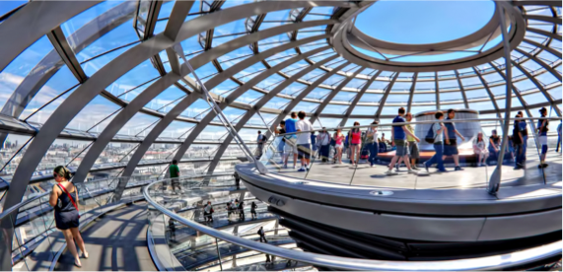
Transparency is beautiful
#3
But confidentiality is critical to business

Slide 16
#3: Confidentiality
Challenge: Square transparency with confidentiality in blockchains.
What IC3 is aiming to do:
Cryptographic approaches (Hawk, Solidus)
Trusted-hardware approaches

Slide 17
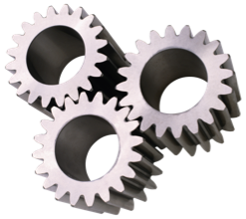
Interesting smart contracts need trustworthy data
Smart Contract
Webpage
contents
Stock quotes
Commodity
prices
Current
events
Weather
data
Sports
results
Today there are no good sources.
#4

Slide 18
#4: Authenticated Data
Challenge: Create robust ecosystem of trustworthy data feeds for blockchains.
What IC3 is aiming to do:
Building high-trust data feeds (Town Crier, Virtual Notary)
Stock quotes
Smart Contract
Webpage
contents
Commodity
prices
Current
events
Weather
data
Sports
results

Slide 19
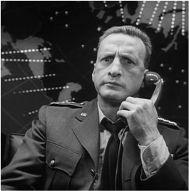
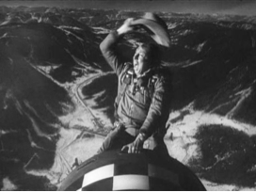
Where there are autonomous agents
#5
Smart Contract

Slide 20
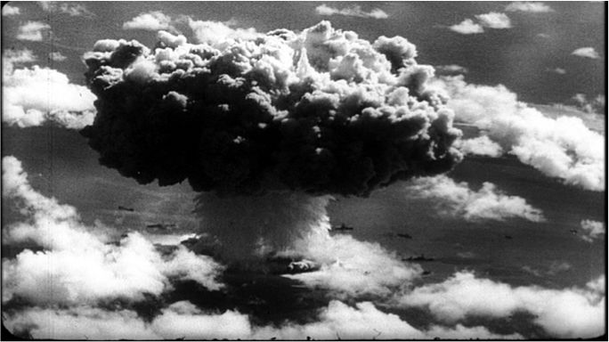
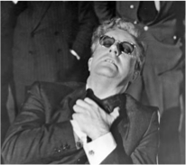
Where there are autonomous agents
#5
Smart Contract
Little accidents will happen

Slide 21
#5: Safety and Compliance
Challenge: Enable effective monitoring and targeted intervention in blockchains.
What IC3 is aiming to do:
Studying traditional contract law and risks of crime in smart contracts
Problem-solving session on regulatory challenges

Slide 22
Goal of Retreat
Determine IC3 agenda
over the next few years
Grand challenges are important but broad
Let's understand problems of key interest to you.
Takeaway: research partnerships
Our first retreat, but we have basic NSF funding for multi-year period
Let's work together to advance the science and applications of blockchains

